Slide 1

INSTITUTE :UIE
DEPARTMENT: ALL ACADEMIC UNITS
Bachelor of Engineering (All Sections)
Subject Name and Code:
Engineering Physics 23SPH-141
Prepared by: Ms. Arminder
UNIT 3
QUANTUM MECHANICS
DISCOVER . LEARN . EMPOWER

Slide 2
COURSE OBJECTIVES
The course is designed to make the students industry ready to contribute in the growing demand of the industry at local, national and international level.
It will make the students competent to understand basic concepts and applications of advanced engineering physics and apply its principles in their respective fields at global platform.
It will enhance the skill level of the students and shall make them preferred choice for getting employment in industry and research labs.
It will give thorough knowledge of the discipline to enable students to disseminate knowledge in pursuing excellence in academic areas.

Slide 3

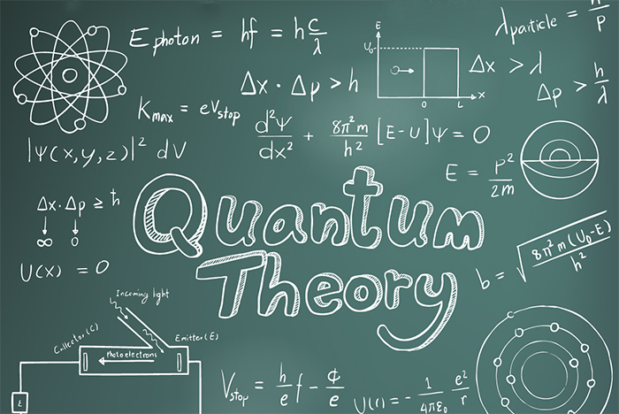
COURSE OUTCOME
CO Number | Title On completion of this course, the students are expected to learn | Level
CO1 | Quote the basic fundamental concepts of lasers, optical fibres, crystallography, ultrasonic oscillations, semiconductor physics, quantum mechanics and nanotechnology. | Remember, Understand
CO2 | Demonstrate the working of various lasers, fibre components, semiconductor devices; explain the behaviour of crystalline solids, quantum and nano-scale systems. | Understand
CO3 | Solve problems by applying principles related to lasers, fibres, semiconductors, oscillations, quantum and nanoscience. | Applying
CO4 | Compare various lasers and fibres, semiconducting devices, crystalline materials, structures at quantum and nanoscale on the basis of their properties for industrial applications. | Analyze
CO5 | Develop various systems using lasers, fibres, semiconductors and nanomaterials for futuristic applications. | Design
Figure 1 Quantum Theory [1]

Slide 4
INTRODUCTION
UNIT -3
QUANTUM MECHANICS
FREE PARTICLE ENERGY, PARTICLE IN A BOX 1-D

Slide 5
LECTURE OBJECTIVE
Students will learn about energy value of free particle.
Students will derive condition of particle box.
Students will learn quantisation of energy in confined state.

Slide 6
CONTENT
FREE- PARTICLE
POTENTIAL WELL
PARTICLE IN A BOX

Slide 7

A FREE PARTICLE
A particle is said to be free when no external force is acting on during its
motion in the given region of space, and its potential energy V is constant.
Let us consider an electro is freely moving in space in positive x direction and
not acted by any force, there potential will be zero.
The Schrodinger wave equation reduces to

Slide 8


A FREE PARTICLE
Substituting, we get
As the electron is moving in one direction (say x axis),
then the above equation can be written as

Slide 9

A FREE PARTICLE
The general solution of the equation (2) is of the form
The electron is not bounded and hence there are no restrictions on k.
This implies that all the values of energy are allowed.
The allowed energy values form a continuum and are given by

Slide 10
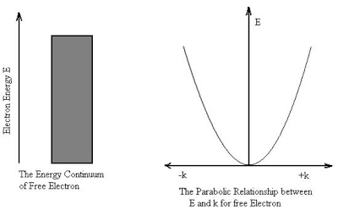
A FREE PARTICLE
The wave vector k describes the wave properties of the electron.
It is seen from the relation that

Slide 11
PARTICLE IN A BOX
In quantum mechanics, the particle in a box model (also known as the infinite potential well or the infinite square well) describes a particle free to move in a small space surrounded by impenetrable barriers. The model is mainly used as a hypothetical example to illustrate the differences between classical and quantum systems. In classical systems, for example, a particle trapped inside a large box can move at any speed within the box and it is no more likely to be found at one position than another.

Slide 12
PARTICLE IN A BOX
However, when the well becomes very narrow, quantum effects become important. The particle may only occupy certain positive energy levels. Likewise, it can never have zero energy, meaning that the particle can never "sit still". Additionally, it is more likely to be found at certain positions than at others, depending on its energy level. The particle may never be detected at certain positions, known as spatial nodes.

Slide 13
PARTICLE IN A BOX
Particle in a one-dimensional Box model
Consider a particle of mass ‘m’ moving inside a one-dimensional potential well of infinite height and finite width ‘a’. Assume potential inside the well as constant. Outside this region potential energy ‘V’ is infinity. As a result, the particle has to move only inside the well like a free particle.

Slide 14
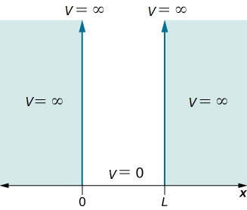
PARTICLE IN A BOX
Fig 3 : Particle in a one dimension box [2]

Slide 15
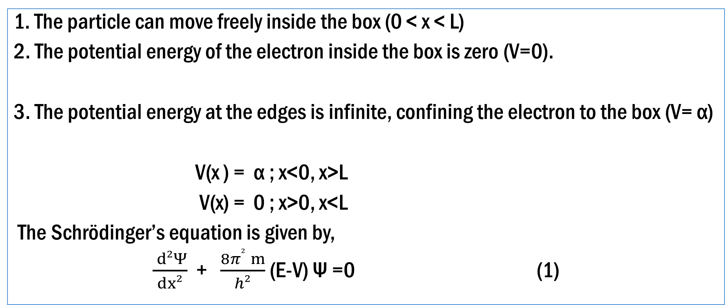
PARTICLE IN A BOX
1. The particle can move freely inside the box (0 < x < L)
2. The potential energy of the electron inside the box is zero (V=0).
3. The potential energy at the edges is infinite, confining the electron to the box (V= α)
V(x ) = α ; x<0, x>L
V(x) = 0 ; x>0, x<L
The Schrödinger’s equation is given by,
$\frac{ d²Ψ}{dx²}$ + $\frac{8π² ­ ­m}{h²}$ (E-V) Ψ =0 (1)

Slide 16
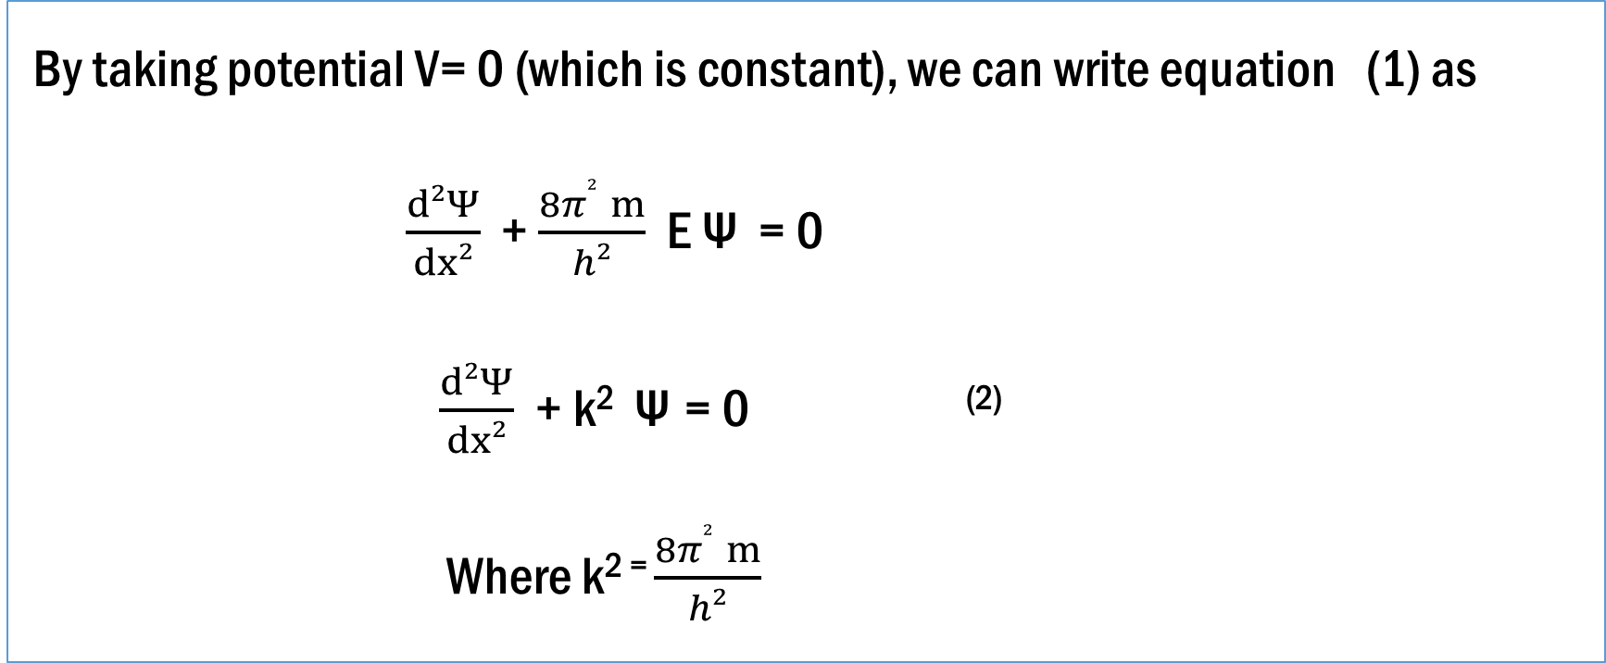
PARTICLE IN A BOX
By taking potential V= 0 (which is constant), we can write equation (1) as
$\frac{d²Ψ}{dx²}$ + $\frac{8π² ­ ­m}{h²}$ E Ψ = 0
$\frac{d²Ψ}{dx²}$ + k^{2­} Ψ = 0 ⁽²⁾
Where k² ⁼ $\frac{8π² ­ ­m}{h²}$

Slide 17
PARTICLE IN A BOX
Discussion of the solution:
The solution of the above equation (2) is given by
Ψ = A cos k x + B sin k x ( 3)
Where A & B are constants depending on the boundary condition.
Now apply boundary conditions for this,
Condition: I At x = 0, ψ = 0.

Slide 18

PARTICLE IN A BOX
From equation (3) we get A = 0.
Condition: II At x = a, ψ = 0
From equation (3) we get, B sin (ka) =0
Since B ≠ 0 Sin ka = 0
K a = n$π$
K =$\frac{nπ}{a}$
k² ⁼ $\frac{n²π²}{a²}$

Slide 19

PARTICLE IN A BOX
Therefore wavefunction Ψ becomes
Ψ= B sin ( $\frac{nπ}{a}$) x (3a)
Substitute the value of k² in equation 2a, we get
$\frac{8π² ­ ­m}{h²}$ = $\frac{n²π²}{a²}$
E = $\frac{n² h²}{8 m a²}$

Slide 20
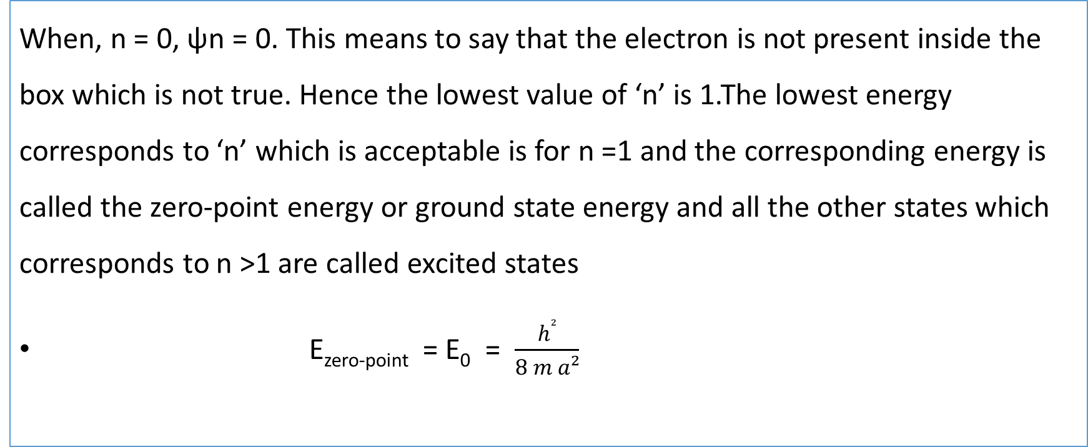
PARTICLE IN A BOX
When, n = 0, ψn = 0. This means to say that the electron is not present inside the box which is not true. Hence the lowest value of ‘n’ is 1.The lowest energy corresponds to ‘n’ which is acceptable is for n =1 and the corresponding energy is called the zero-point energy or ground state energy and all the other states which corresponds to n >1 are called excited states
E_{zero-point} = E₀ = $\frac{h²}{8 m a²}$

Slide 21

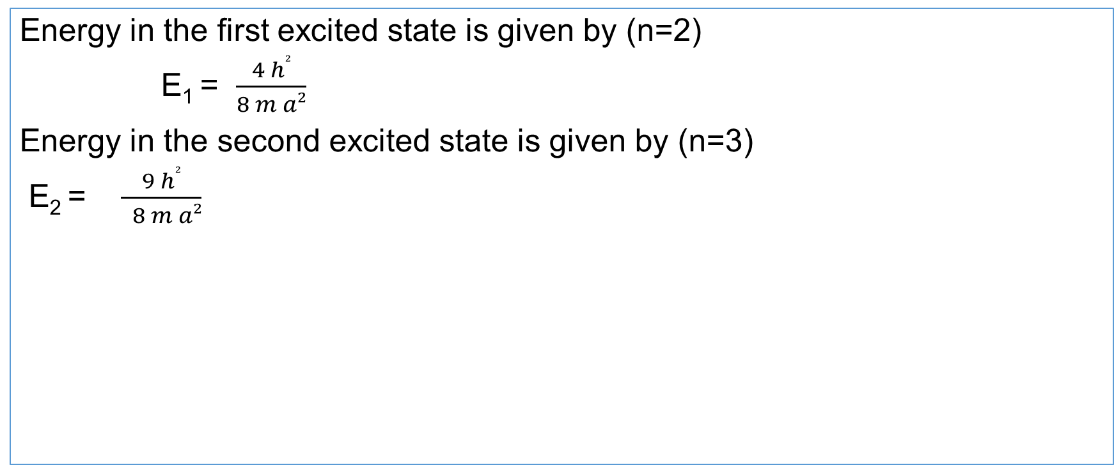
PARTICLE IN A BOX
Energy in the first excited state is given by (n=2)
E₁ = $\frac{4 h²}{8 m a²}$
Energy in the second excited state is given by (n=3)
E₂ = $\frac{9 h²}{ 8 m a²}$
E_{n} = $\frac{n² h²}{ 8 m a²}$

Slide 22
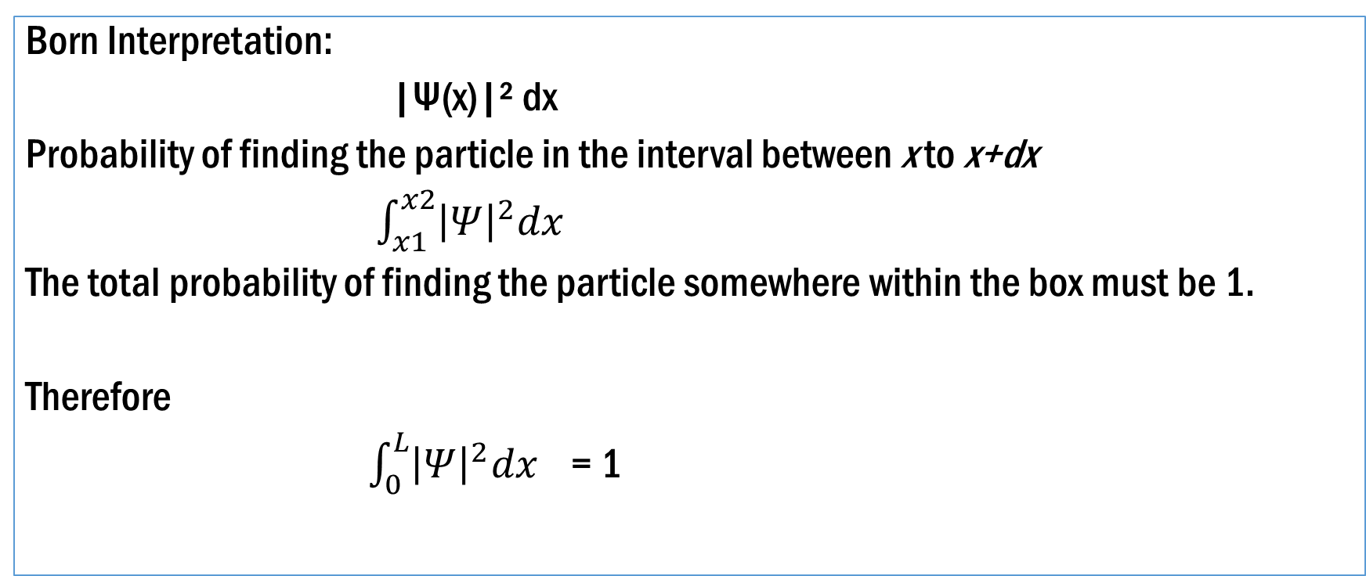
PARTICLE IN A BOX
Born Interpretation:
|Ψ(x)|² dx
Probability of finding the particle in the interval between x to x+dx
$\int_{x1}^{x2}{{\left|Ψ\right|}^{2}dx}$
The total probability of finding the particle somewhere within the box must be 1.
Therefore
$\int_{0}^{L}{{\left|Ψ\right|}^{2}dx}$ = 1

Slide 23

PARTICLE IN A BOX
The integral we need to calculate is:
$\int_{0}^{L}{B² sin ² ( \frac{nπ}{a}) x dx}$ =1
We get B = ( $\frac{2 }{L}$)^{½}
Therefore Normalised Wavefunction becomes
Ψ_{n} = ( $\frac{2 }{L}$)^{½} sin ( $\frac{nπ}{a}$) x

Slide 24
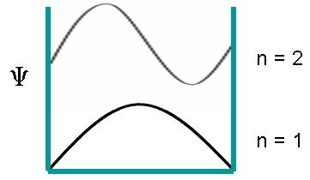
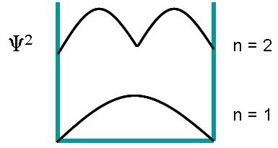
PARTICLE IN A BOX
Fig 4a : Wavefunction of a particle Fig 4b : Probability of Particle [3]

Slide 25
SUMMARY
The energy of a particle is quantized. This means it can only take on discrete energy values.
The lowest possible energy for a particle is not zero (even at 0 K). This means the particle always has some kinetic energy.
The square of the wavefunction is related to the probability of finding the particle in a specific position for a given energy level.
The probability changes with increasing energy of the particle and depends on the position in the box you are attempting to define the energy for
In classical physics, the probability of finding the particle is independent of the energy and the same at all points in the box.

Slide 26
FREQUENTLY ASKED QUESTIONS
Is energy continuous in case of free particle?
How can we normalised wave function?
Derive wave function for one-dimensional particle in a box.

Slide 27
REFERENCE-BOOKS
Concepts of Modern Physics, (Fifth Edition) A Beiser, McGraw Hill International.
Fundamentals of Physics, David Halliday, Robert Resnick and Jearl Walker, Wileyplus.

Slide 28
IMAGE REFERENCE
[1] https://sites.google.com/site/puenggphysics/home/unit-iv/a-free-particle
[2] https://www.seekpng.com/ipng/u2q8u2y3w7q8i1o0_particle-in-one-dimensional-box/
[3]https://chem.libretexts.org/Bookshelves/Physical_and_Theoretical_Chemistry_Textbook_Maps/Map%3A_Physical_Chemistry_for_the_Biosciences_(Chang)/11%3A_Quantum_Mechanics_and_Atomic_Structure/11.08%3A_Particle_in_a_One-Dimensional_Box#:~:text=A%20particle%20in%20a%201,from%20which%20it%20cannot%20escape.

Slide 29
REFERENCE-WEBSITE
http://www.physics.umd.edu/courses/Phys270/Jenkins/LectureChapters41v3.pdf
https://iopscience.iop.org/book/978-0-7503-1206-6/chapter/bk978-0-7503-1206-6ch2
https://sites.google.com/site/puenggphysics/home/unit-iv/a-free-particle

Slide 30
Video link
https://www.youtube.com/watch?v=lGKKdLmRNQw
https://www.youtube.com/watch?v=zxn9SwYtzgw

Slide 31
THANK YOU
For queries
Email: arminder,uis@cumail.in

